Slide 1
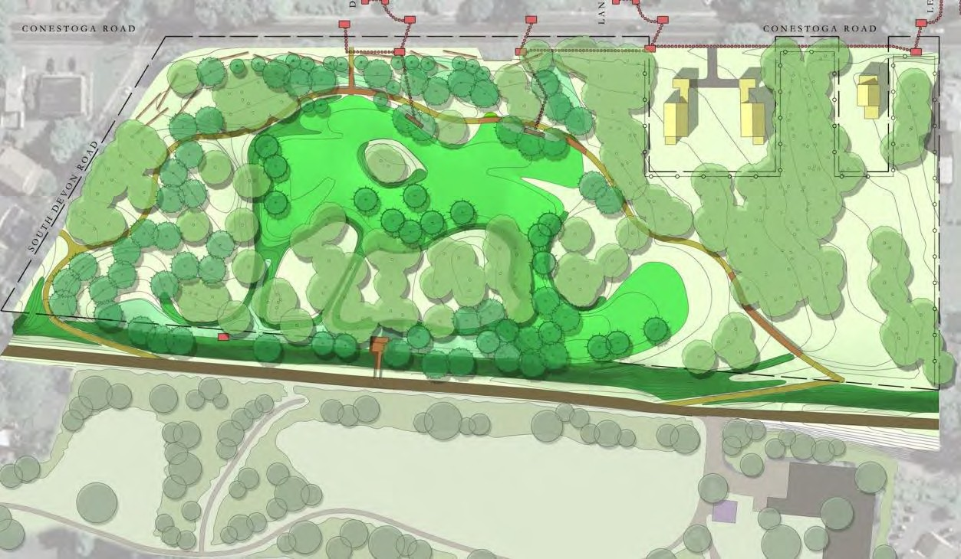




West Wayne Preserve
Green Stormwater Infrastructure and Park Improvements
Conceptual Plan
Conestoga Road

Slide 2
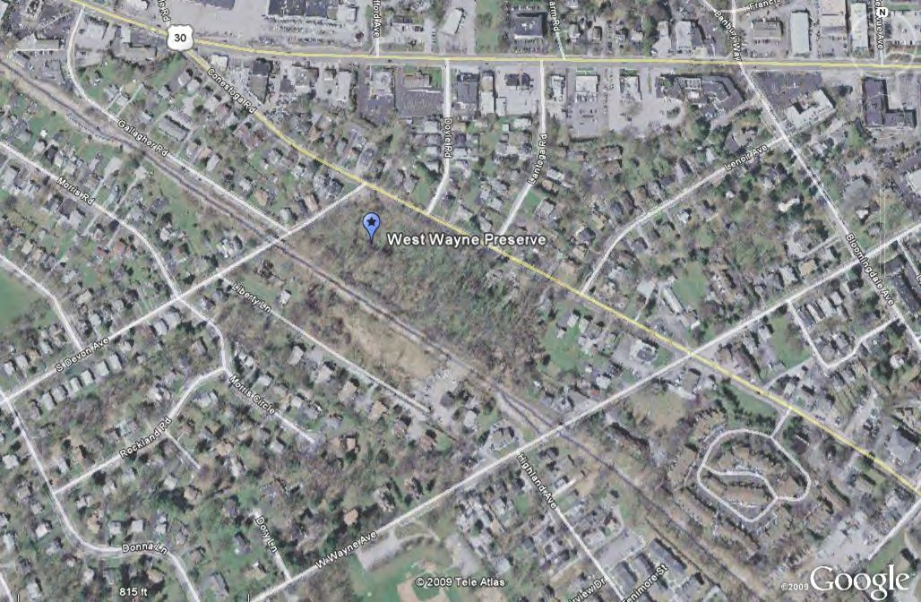

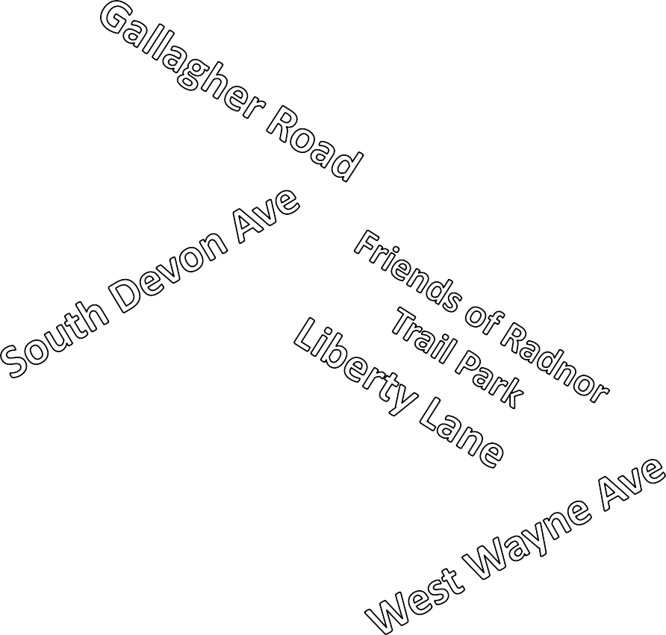





Site Location
West Wayne Preserve
7.8 Ac.

Slide 3
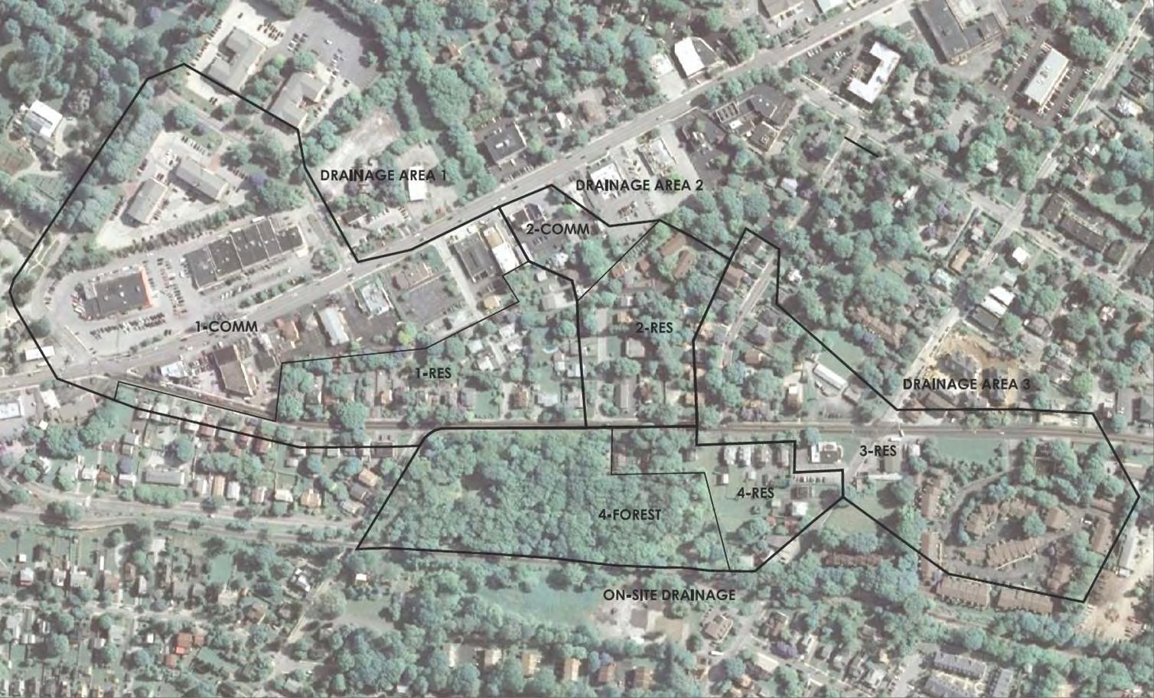



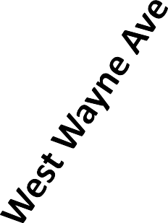



44 Acres Flow into Site
Kitchen Kapers
Lantoga
AutoWash
Conestoga Road
West Wayne
Preserve
Total Drainage = 44.1 acres off site
3/4” rainfall volume +/- 89,000 cubic feet

Slide 4
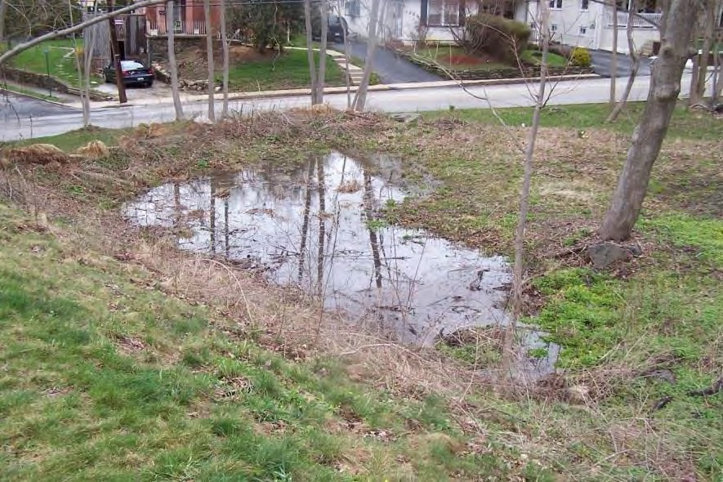
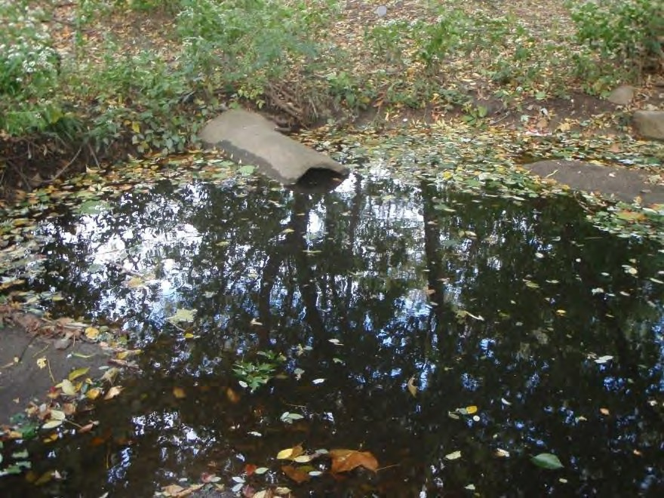
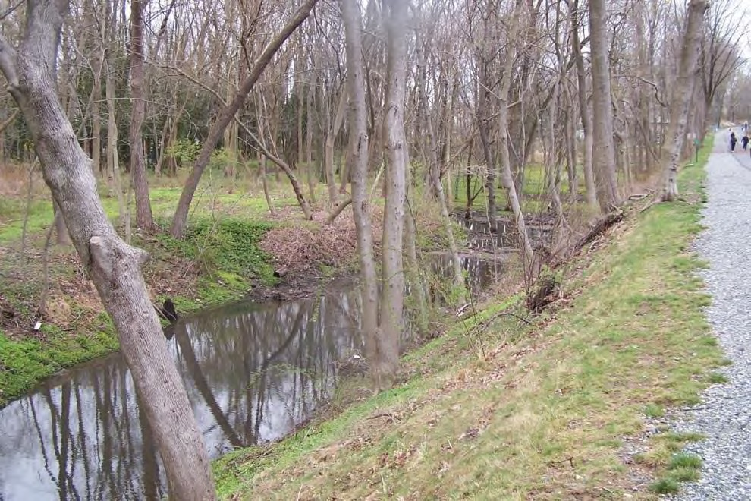
Existing Conditions
Stagnant Water –
Mosquito breeding

Slide 5
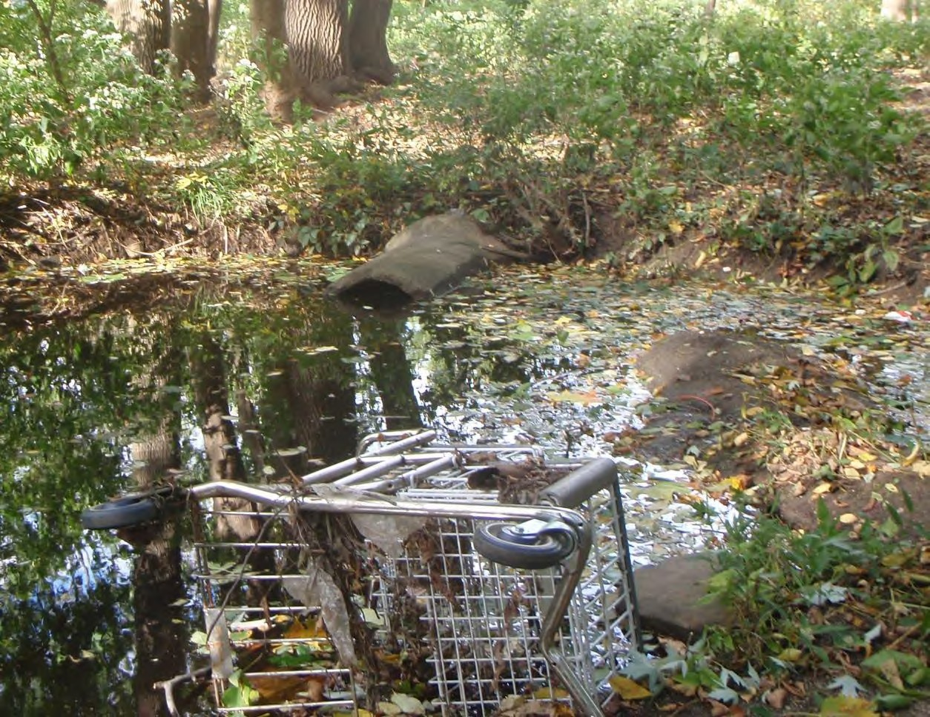
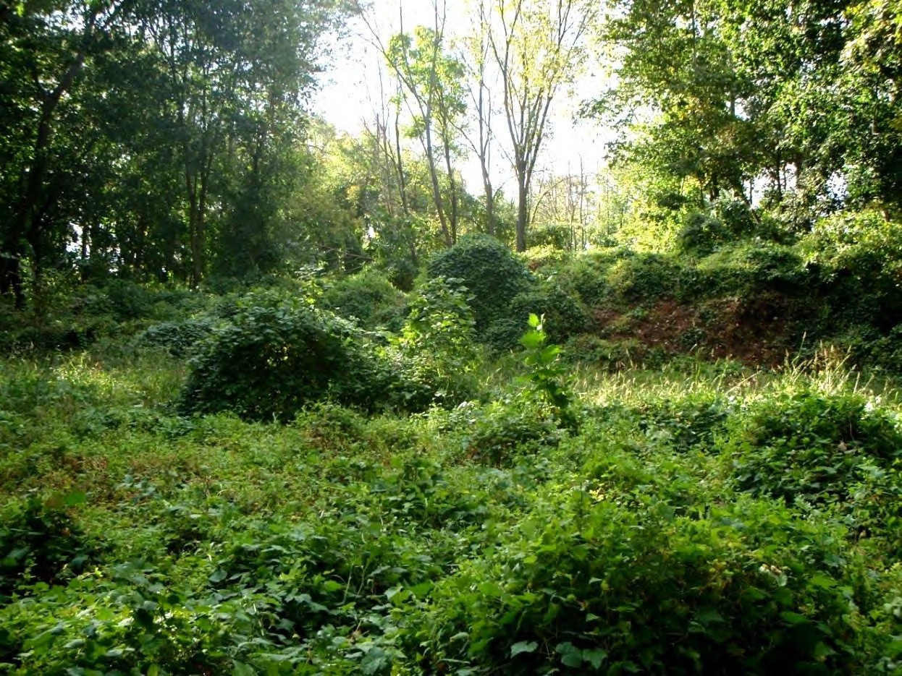
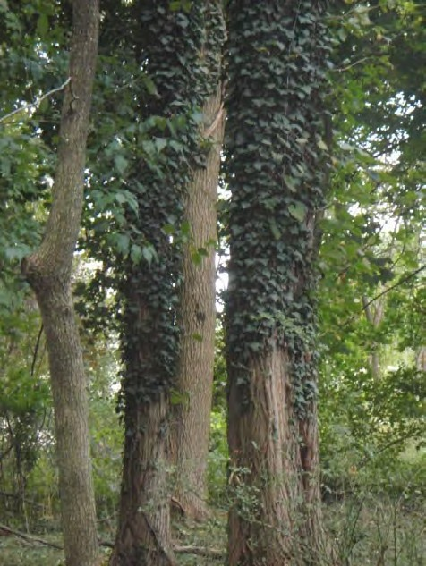
Existing Conditions
Dumped debris and soil mounds
Non-Native Invasive Species – low quality habitat
Norway Maple, English Ivy, Japanese Knotweed…

Slide 6
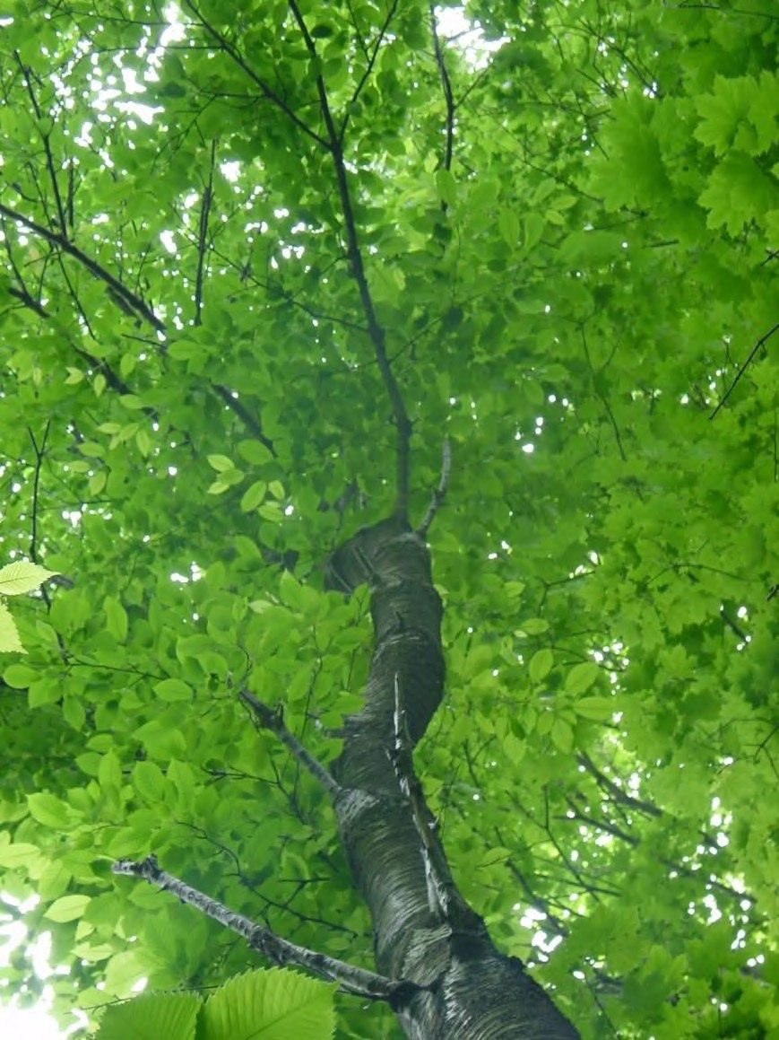
Project Goals:
Manage Stormwater and Create Park
Capture first 3/4-inch of stormwater runoff from off- site areas
-slow, clean, infiltrate
Alleviate erosion and flooding
Eliminate existing stagnant water
Restore native plant community – wooded wetlands
Increase habitat value
Invite people into and involve them in the park

Slide 7
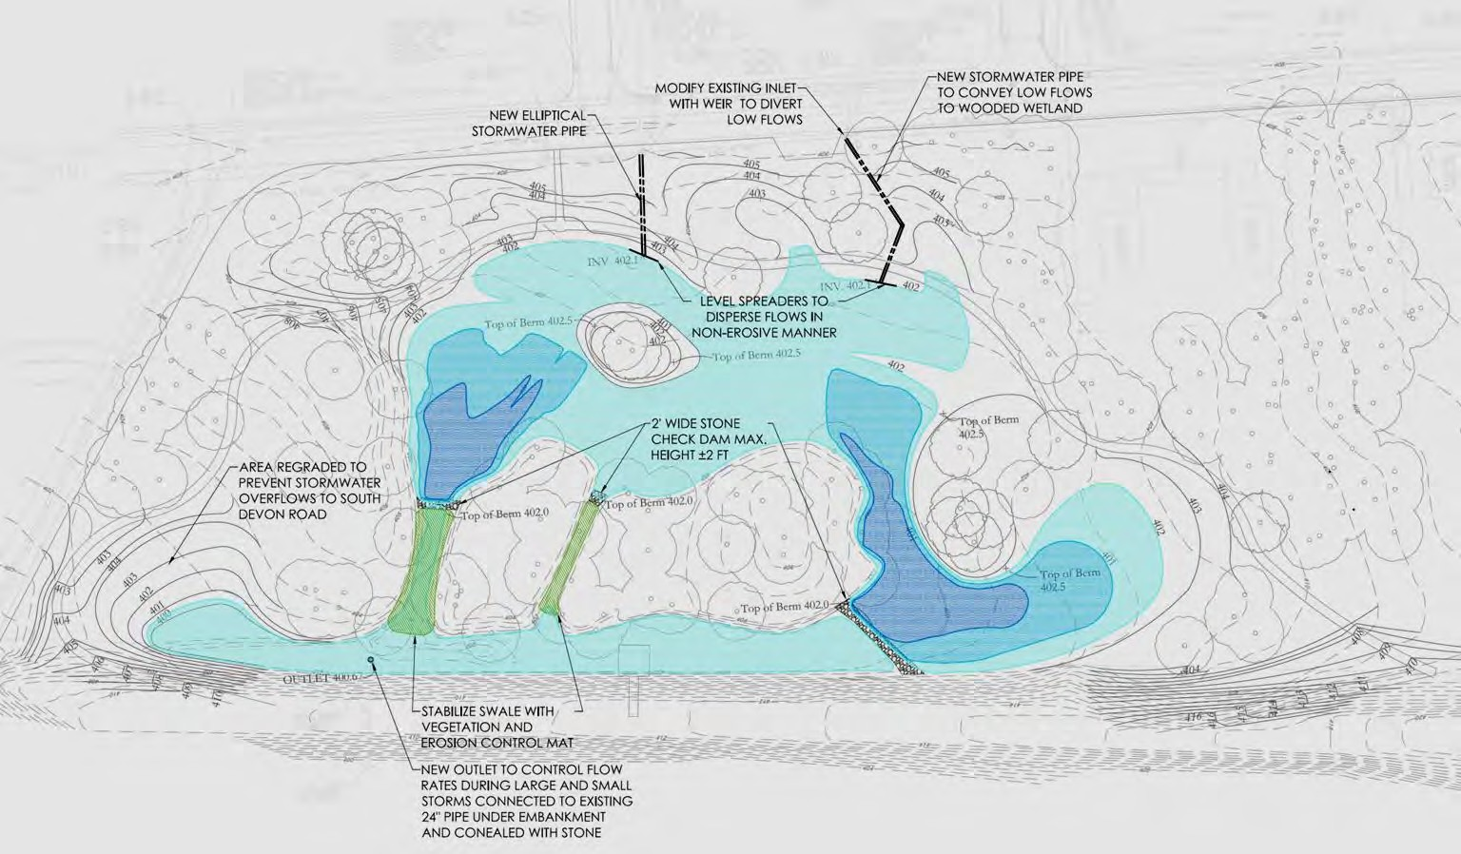
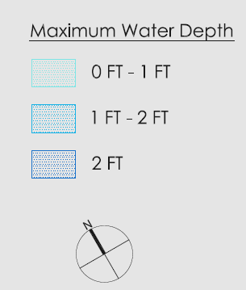


Stormwater Plan
Outflow Towards Little Darby Creek

Slide 8
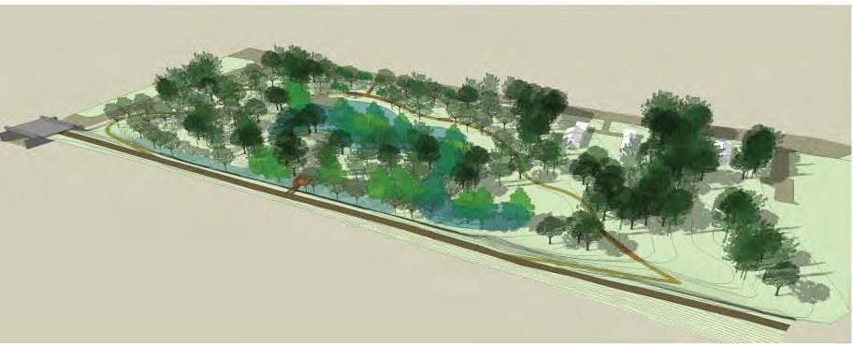


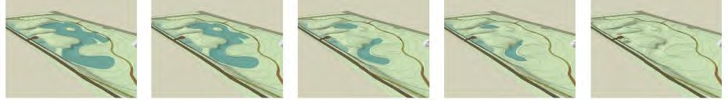
Stormwater Diagrams
Maximum Water Level
Water Levels after Storm Event
12 Hours
24 Hours
36 Hours
48 Hours
66 Hours

Slide 9
Stormwater Volume Metrics
83,522 CF storage capacity
1,475,000 CF of storage per year
Evapotranspirate, Infiltrate, Slow Release
Pollutant removal from the treated volume
Total Suspended Solids
Phosphorus
Metals
Nitrogen
Organics
Bacteria
Soil and Plants provide these improvements

Slide 10
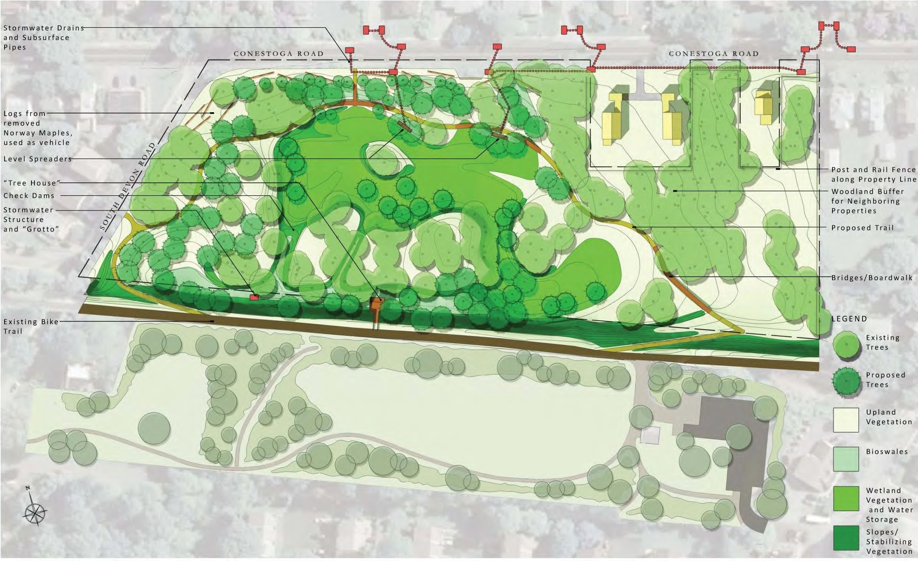
Park Master Plan
Public amenity. Views into the site. Trails and boardwalks
Woodland restoration

Slide 11
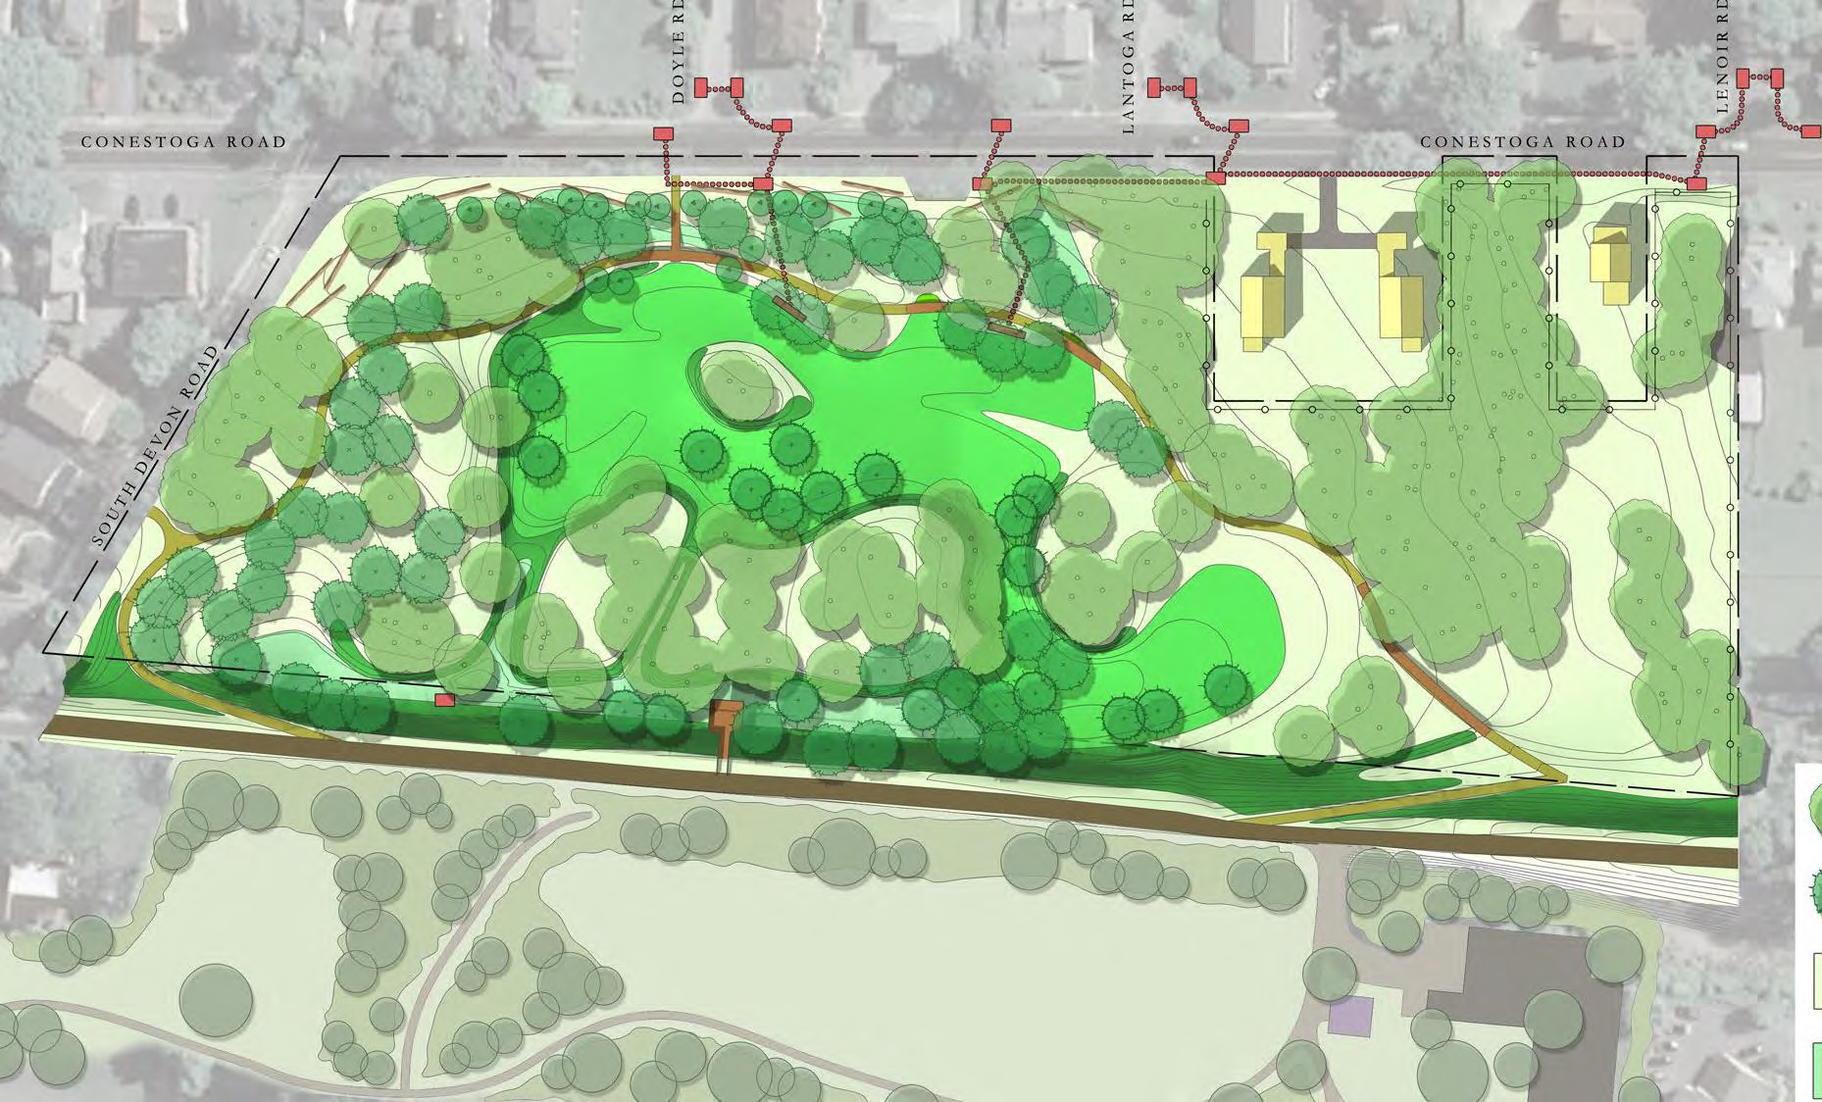

Entrance Ramps
Ramped walks connect to Radnor Trail to allow access to a loop around the West Wayne Preserve and connecting to sidewalks.

Slide 12
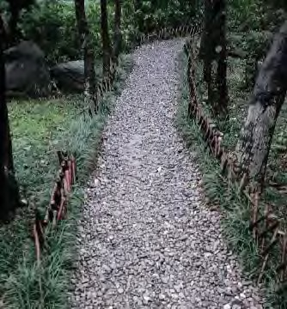
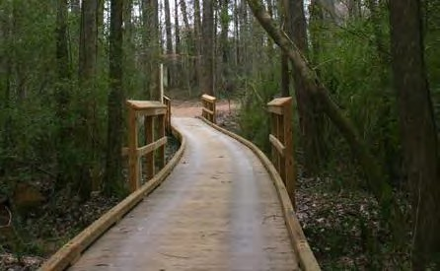
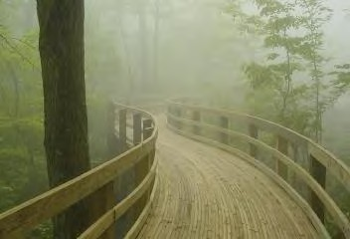
Paths & Boardwalks

Slide 13
Buffer Areas
The existing trees adjacent to the contiguous neighbors will be
preserved to maintain the neighbors’ privacy.

Slide 14
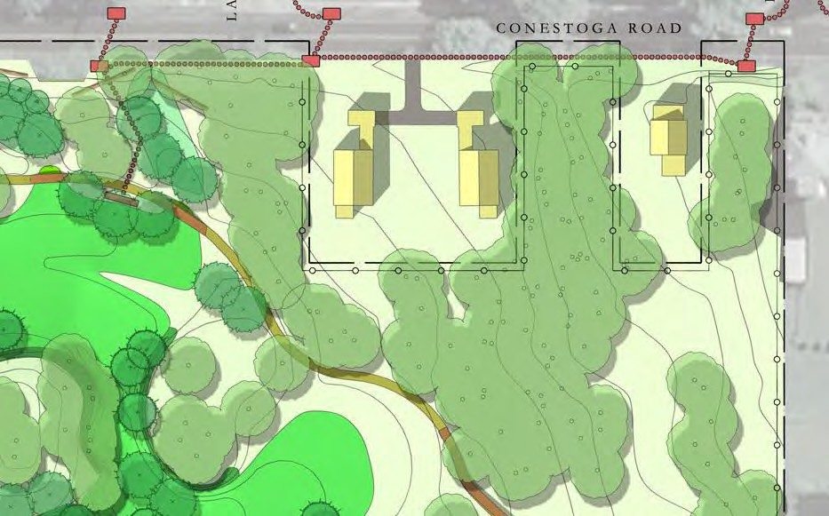
Buffer Areas
The loop path will be located away from the neighbors to help
maintain their privacy.

Slide 15
Buffer Areas
The frontage along Conestoga Road will be planted with small shade
and sub canopy trees to mitigate the impact of the traffic.

Slide 16
Next Steps
Funding and Implementation for: Survey, Design and Permitting Construction
Extended Landscape Management

Slide 17
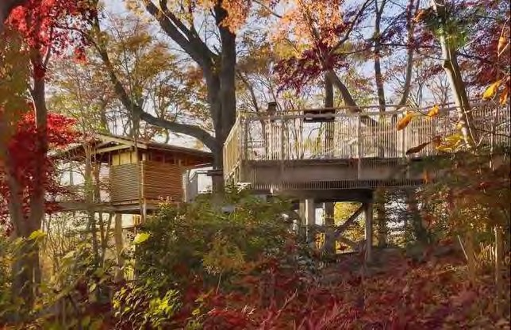
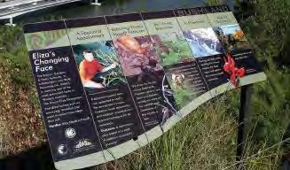
Observe, Learn, & Enjoy

Slide 18
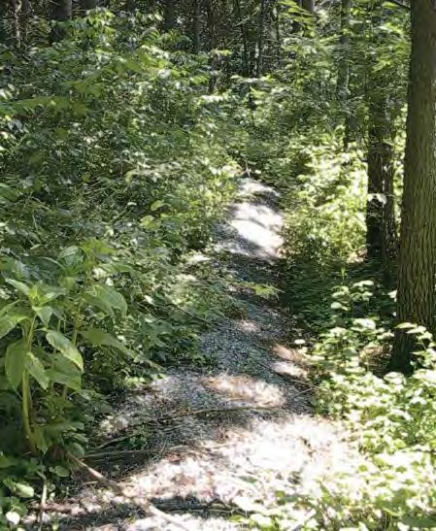
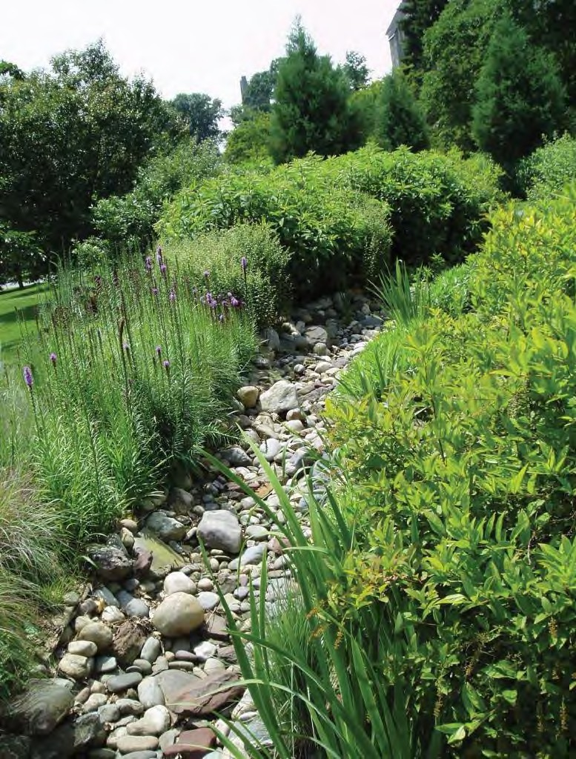
Bioswale
Level Spreader

